Slide 1



Data-driven Estimation of Flowing Bottom-Hole Pressure in Petroleum Wells using Long Short-Term Memory
MSc. Mateus de Araujo Fernandes
Prof. Dr. Marcio Augusto Sampaio Pinto
Prof. Dr. Eduardo Gildin
Miami, December 2024
Universidade de São Paulo
Notes:
- Good morning, I’m Mateus Fernandes and today I’ll present an application of deep learning in the Oil & Gas industry, specifically estimating Bottom-hole pressures in producing wells.

Slide 2
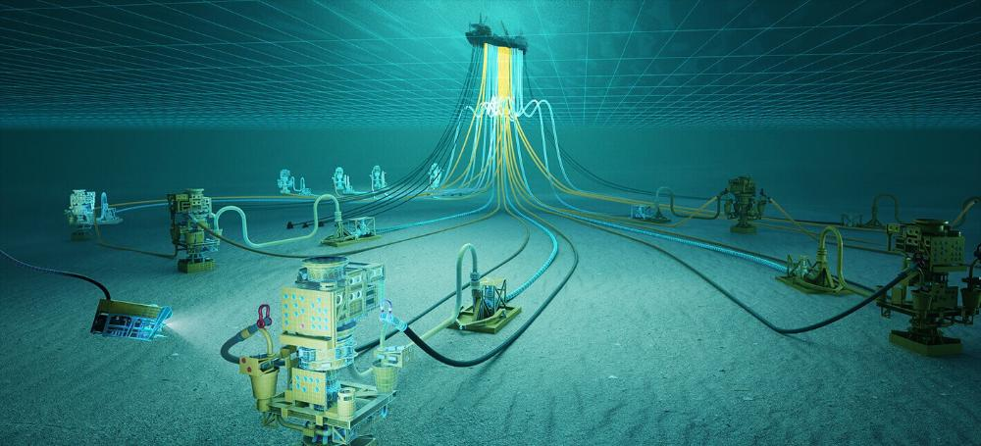
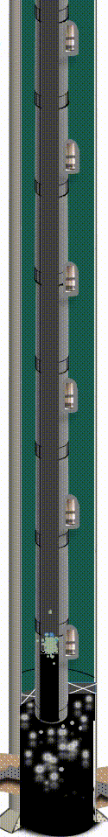
Offshore Production System
Platform
Reference: Petrobras
Wellhead
2
Notes:
I start with a brief contextualization, showing a schematic view of a submarine arrangement around an offshore deepwater platform
Highlight the connections between wells and the platform, with pipelines for production and injection, plus electrical and hydraulical connections
Underground we have wells with that structure
Production flows from the bottom of wells to the wellheads at seabed, then to the platform through subsea lines that can be a few miles long and have variable geometries

Slide 3
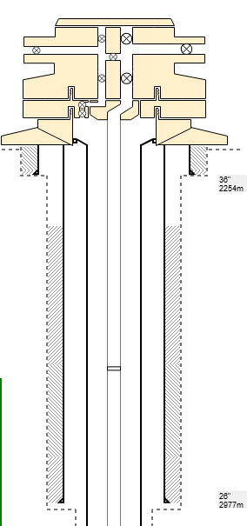
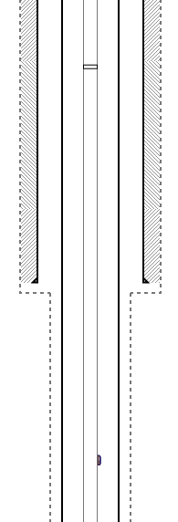
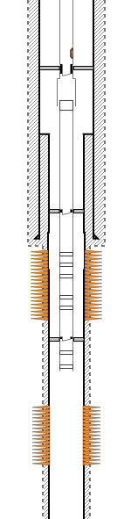
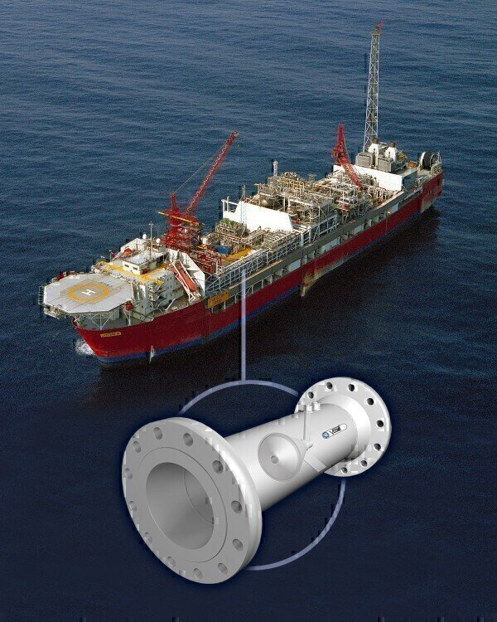
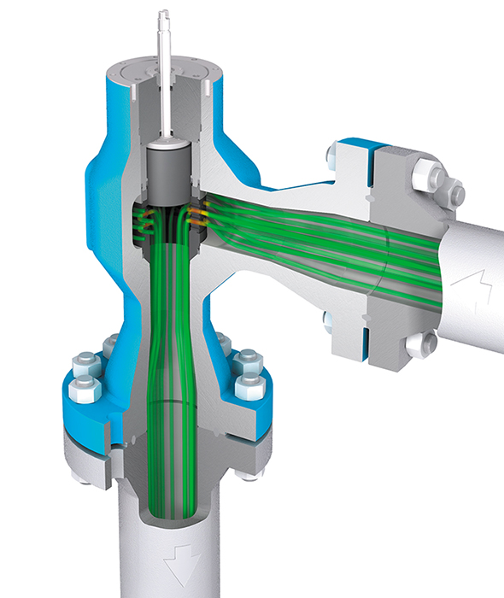
Production Monitoring
Permanent Downhole Gauge
(Pressure and Temperature)
Topside variables:
Production rates (oil, gas, water)
Choke Aperture
Choke inlet Pressure
Choke inlet Temperature
Wellhead variables:
TPT Pressure
TPT Temperature
Downhole variables:
PDG Pressure
PDG Temperature
Reference: mokveld.com
Reference: petro-online.com
Failures are more critical
Reference: Petrobras
3
Notes:
Production monitoring as viewed by reservoir and flow assurance engineering
At the platform we have measures of production rates
And also the measures of P and T in the choke valve (the one which controls production flow for each well)
At the wellheads (seabed) we have Temperature and Pressure Transducers (and one more set of control valves)
PDGs are the most important for reservoir monitoring and the more prone to fail. Their replacement is far more expensive (requiring heavy workover) indeed.
That’s the motivation for our work as we estimate the values of the downhole pressure.

Slide 4
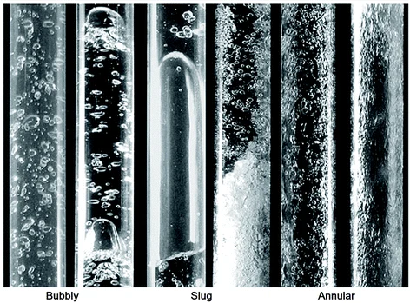
Multiphase Flow & Flowing BHP Estimation
Flow of Oil + Water + Gas
Complexity of the relations due to flow conditions (variation along the well and pipelines)
Conditions change through time due to Reservoir depletion, water and gas breakthroughs, well’s restrictions, etc
Traditional methods to estimate pressure drops include classical correlations and numerical simulation
Other works in the literature have important limitations
Reference: Introduction to Multiphase Flow (Yadigaroglu et al., 2017)
4
Notes:
-It’s a challenging task because we are dealing with multiphase flow (mix of vertical/horizontal)
- We are trying to fill a gap with data-driven methods.

Slide 5
Objectives & Contributions
Objective:
Estimating the flowing Bottom-Hole Pressure reliably using data from wellhead and topside sensors, replacing a faulty/absent PDG with a virtual meter (“soft sensor”).
Main features of our framework:
Deep Learning with Time-related data
Suitability for a broad range of reservoir and flow conditions
Application as virtual meter where PDG is not available, including real-time monitoring.
5

Slide 6
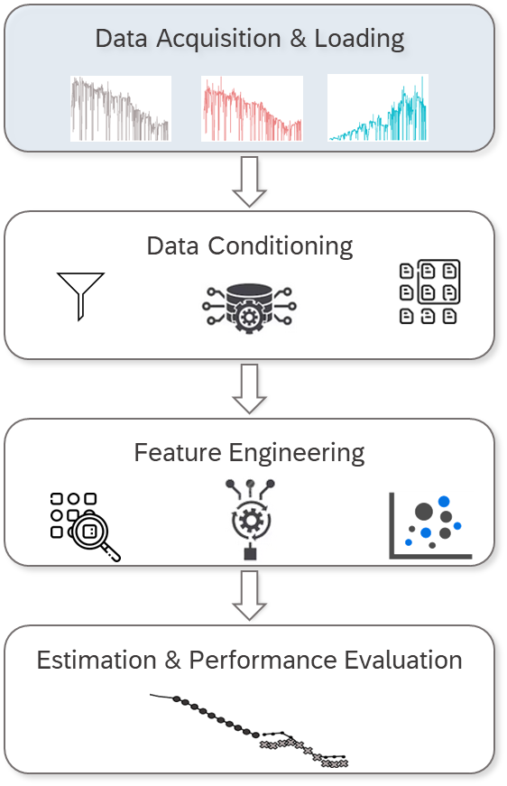




Data Acquisition
5 Wells
6 Years of data
11 Variables
7k Daily samples
6
Notes:
Our framework starts with data acquisition
Proof of concept with data from one platform producing from the Brazilian Pre-Salt reservoirs
We take a look at 11 variables initially
Convert continuous sensor data to daily averages to make them compatible with rates

Slide 7
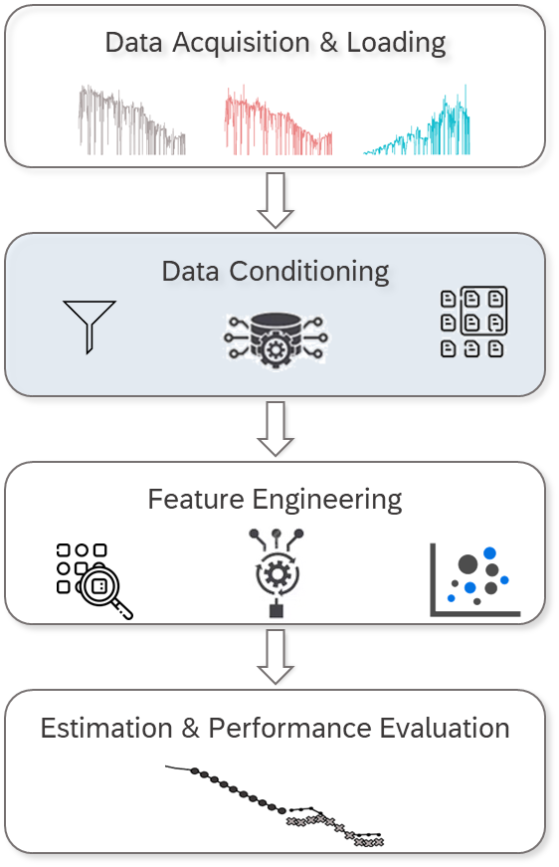
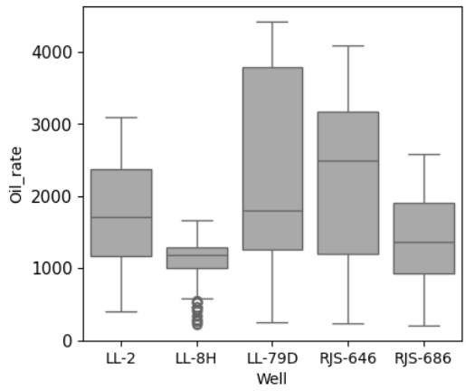
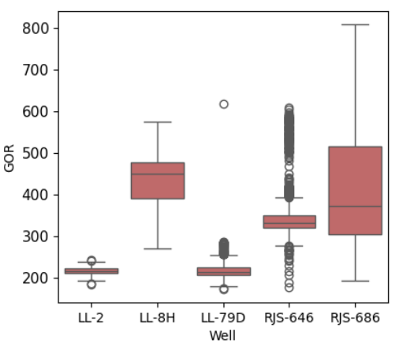
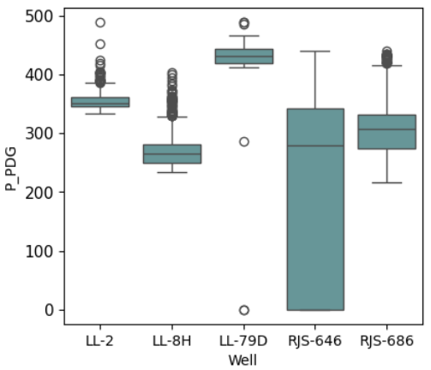
Data Conditioning
Oil rate (m³/d)
GOR
P_PDG (kgf/cm²)
P-2 P-8 P-9 P-46 P-86
P-2 P-8 P-9 P-46 P-86
P-2 P-8 P-9 P-46 P-86
7
Notes:
Example of 3 variables (oil rate, gas-oil ratio, and BHP), showing the ranges for each well
We performed outlier removal and other steps in data conditioning

Slide 8
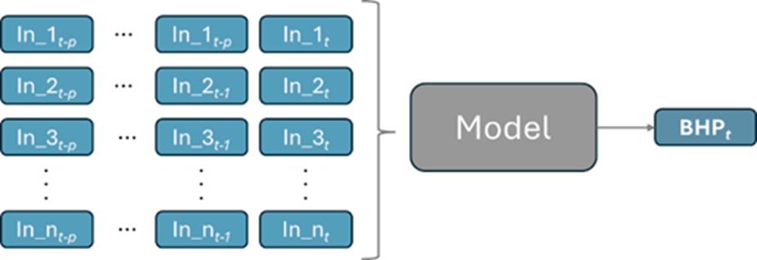
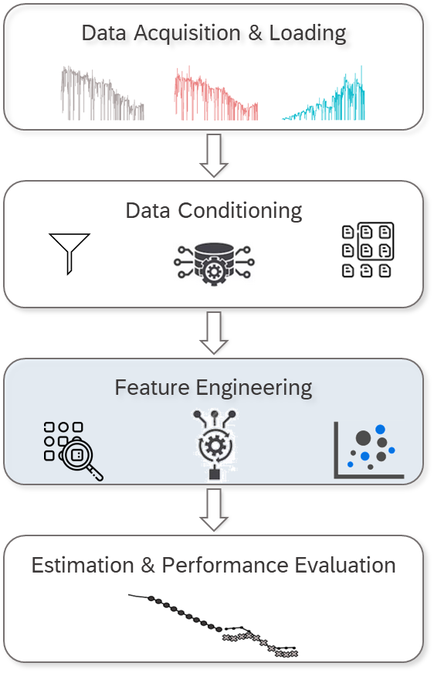
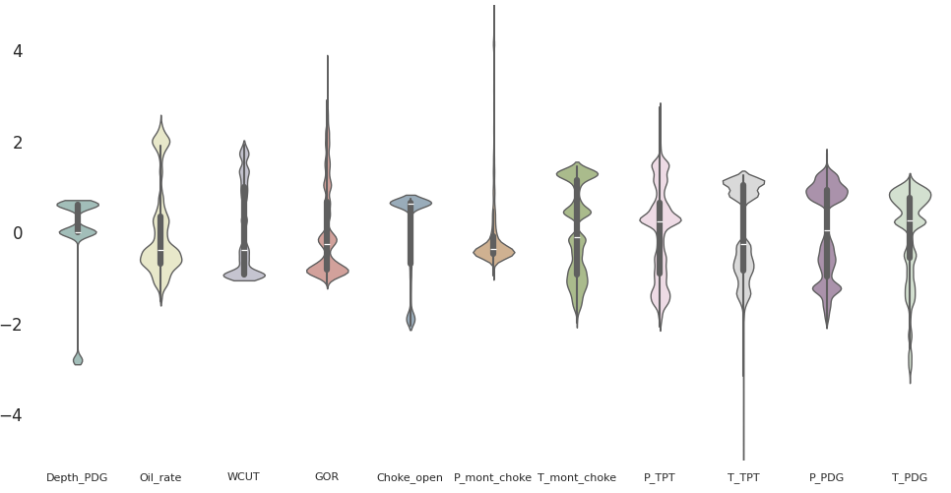
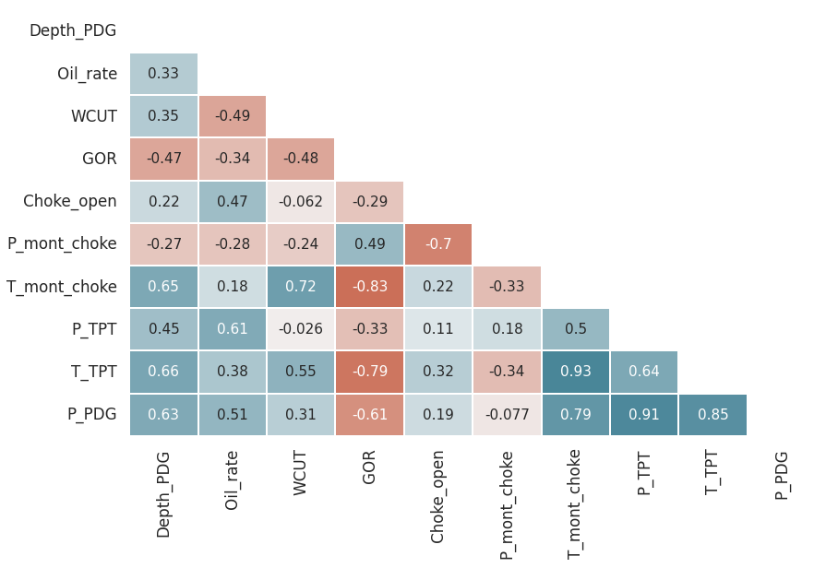
Feature Engineering
8
Notes:
Following, we performed some feature engineering steps:
Analysis of correlations between variables
Normalization and posterior Distribution Analysis
Adjusted the Set of variables and the Timeframes to compose our input datasets

Slide 9
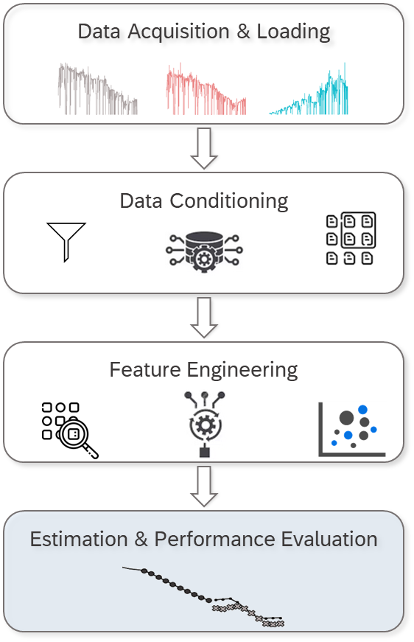
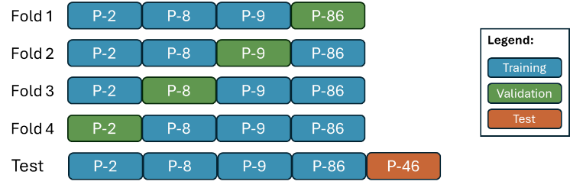
Dataset Preparation
9
Notes:
We performed N-fold cross validation segregating wells
One well used exclusively as test dataset

Slide 10
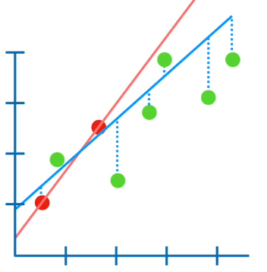
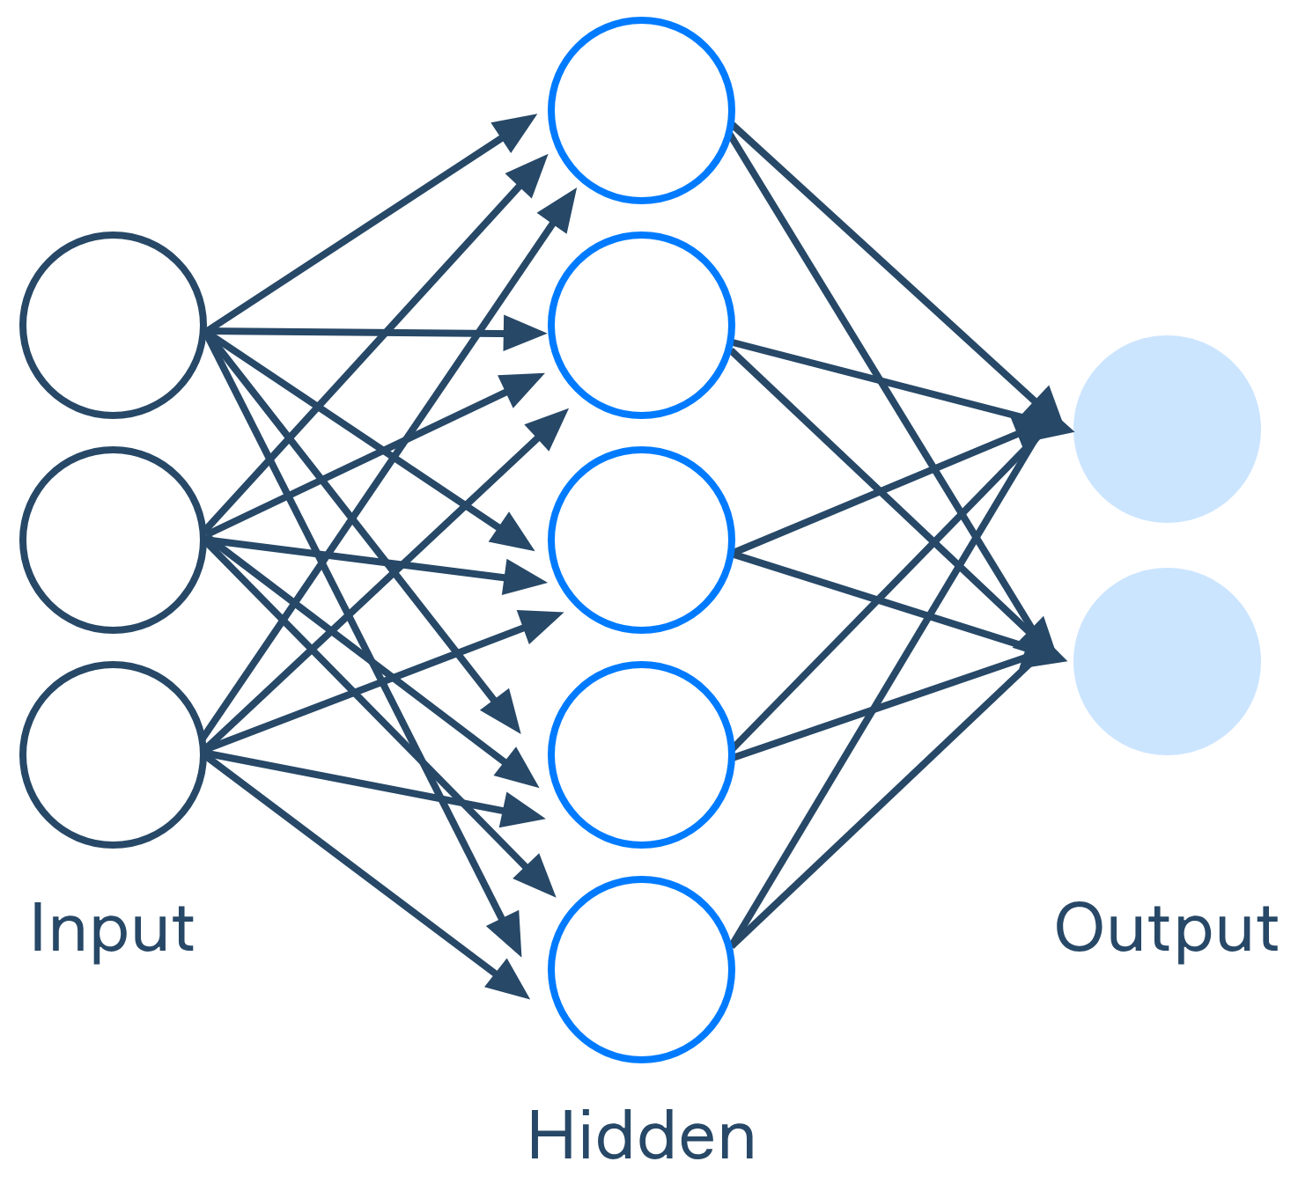
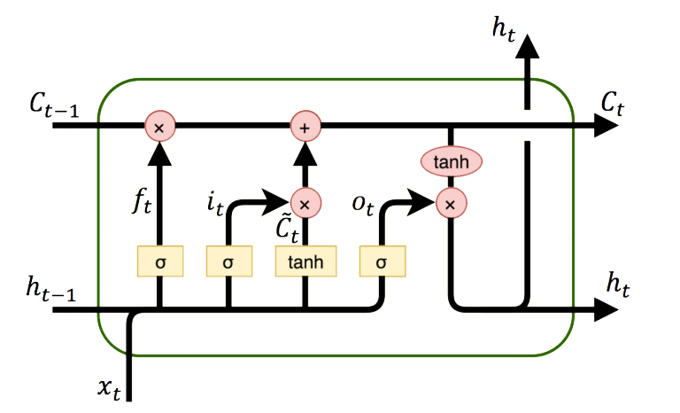
Machine Learning Models
Ridge Regression
α [0.1 – 1.0]
layers [1 – 2]
neurons [10 – 100]
activations [linear, relu, tanh]
MLP Network
elements [10 – 200]
timesteps [3 – 15]
activations [linear, relu, tanh]
LSTM Network
10
Notes:
Two benchmark models: linear regression with regularization and Neural Network
LSTM is our flagship model, incorporating time-related data
The methods were evaluated using a broad range of hyperparameters

Slide 11





Performance after Hyperparameter Tuning
Oil Rate
Gas Rate
Choke Op.
Choke Pressure
Wellhead Pressure
Wellhead Temperature
11
Notes:
We compared:
Best configurations of the benchmark models
3 best LSTM configurations
We used the Mean Absolute Percentage Error and the Symmetric Mean Absolute Percentage Error
Errors under 3%, but the LSTM was not far superior to the other methods

Slide 12
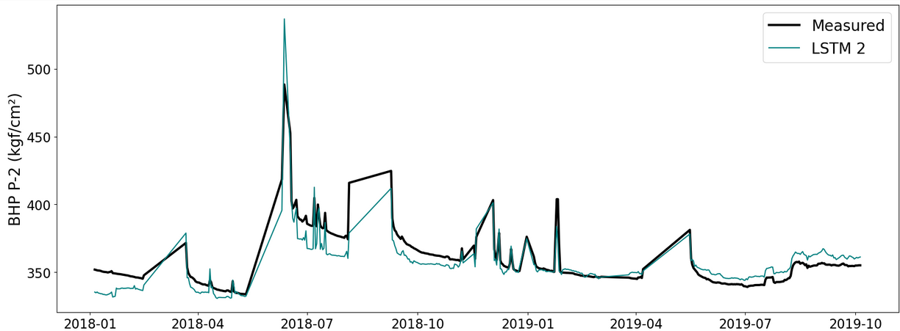
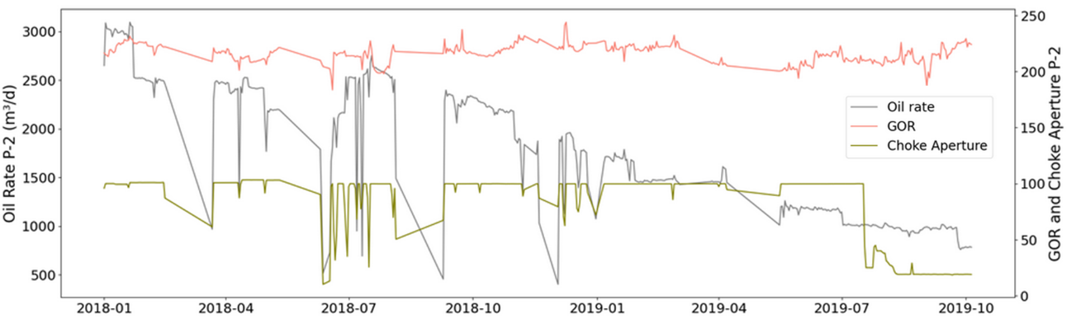
Results: Well P-2
12
Notes:
Well in the validation dataset, with pressure estimated for a ~2 years period
We show some of the inputs to exemplify operational conditions and noise

Slide 13
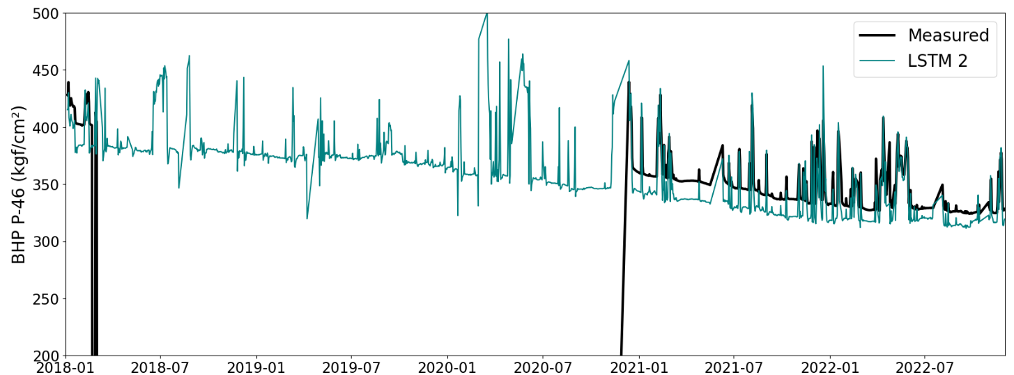
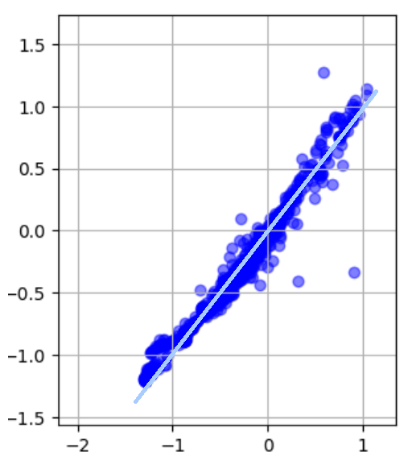
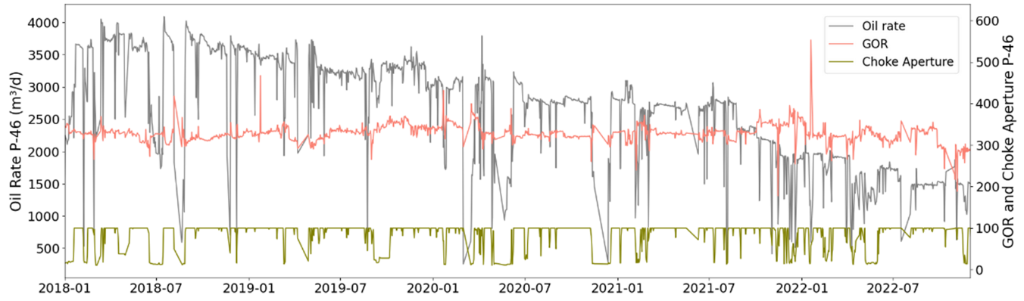
Results: Well P-46 (Blind test)
PDG
13
Notes:
Well of the test dataset
Errors Around 3%, even considering more noisy conditions (more variation in operational conditions)
Period where PDG was unavailable in real life

Slide 14
Conclusions
Proof of concept with pure data-driven framework.
Relevant application for reservoir/flow assurance studies and monitoring.
Method proven robust to concept drift, working well for a broad range of conditions.
Value of the method: bringing information when sensors fail and avoiding costs for substitutions or (in some cases) new installations.
14

Slide 15

Data-driven Estimation of Flowing Bottom-Hole Pressure in Petroleum Wells using Long Short-Term Memory
matfernan@petrobras.com.br
Universidade de São Paulo

